Slide 1
Lecture 12
The Normal Distribution
The Central Limit Theorem

Slide 2
The Normal Distribution
The normal distribution is the single most important probability distribution.

Slide 3
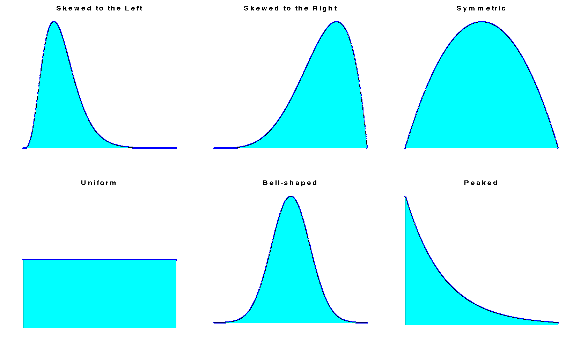
Continuous Distribution

Slide 4
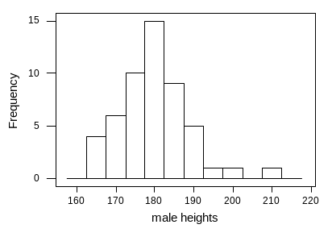
Normal distribution
Many real -life data sets look like this one, the name given to this general shape is “normal”

Slide 5
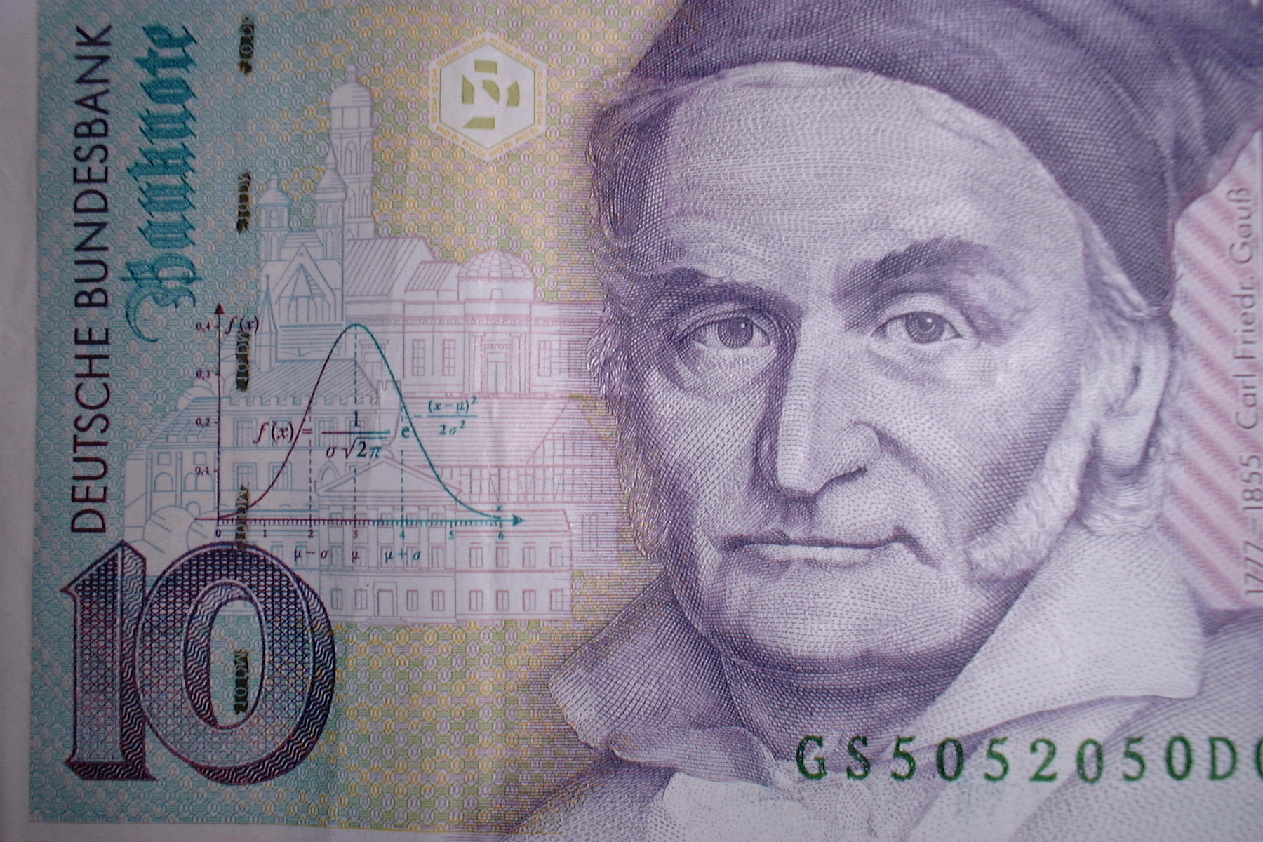

Slide 6
Importance of Normal Distribution
1. Describes Many Random Processes or Continuous Phenomena
2. The central limit theorem.
If a large random sample is taken from some distribution, then even though this distribution is not itself approximately normal, many important functions of the observations in the sample will have distributions which are approximately normal.
3. Basis for Classical Statistical Inference

Slide 7


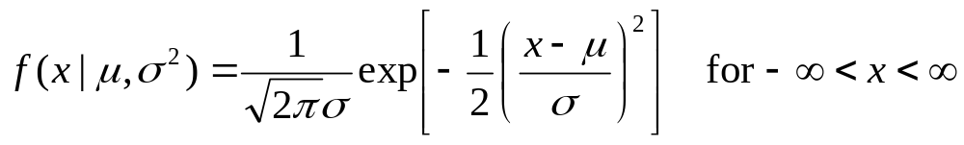
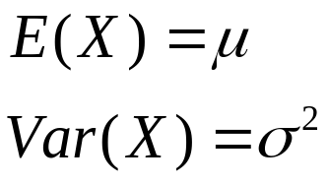
Definition of the Normal Distribution
A random variable X has a normal distribution with mean and variance
if X has a continuous distribution with p.d.f.

Slide 8

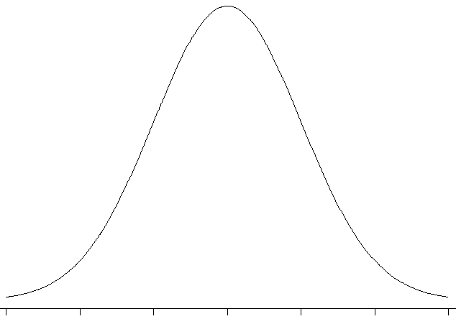

The Shape of the Normal Distribution
The p.d.f. of a normal distribution is symmetric with respect to the point x=μ.

Slide 9



Linear Transformation
Theorem . If X has a normal distribution with mean
and variance and if Y=aX+b, where a and b are given constants and , then Y has a normal distribution with mean and variance .

Slide 10


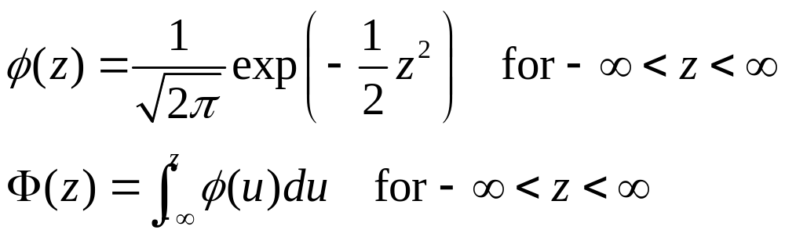
The Standard Normal Distribution
The normal distribution with mean 0 and variance 1 is called the standard normal distribution. The p.d.f. of Z that follows the standard normal distribution is denoted by the symbol , and the d.f. is denoted by the symbol .

Slide 11
Normal Distribution Thinking Challenge
You work in Quality Control for GE. Light bulb life has a normal distribution with
μ = 2000 hours & σ = 200 hours. What’s the probability that a bulb will last
A. between 2000 & 2400
hours?
B. less than 1470 hours?

Slide 12
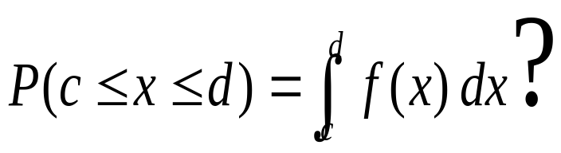

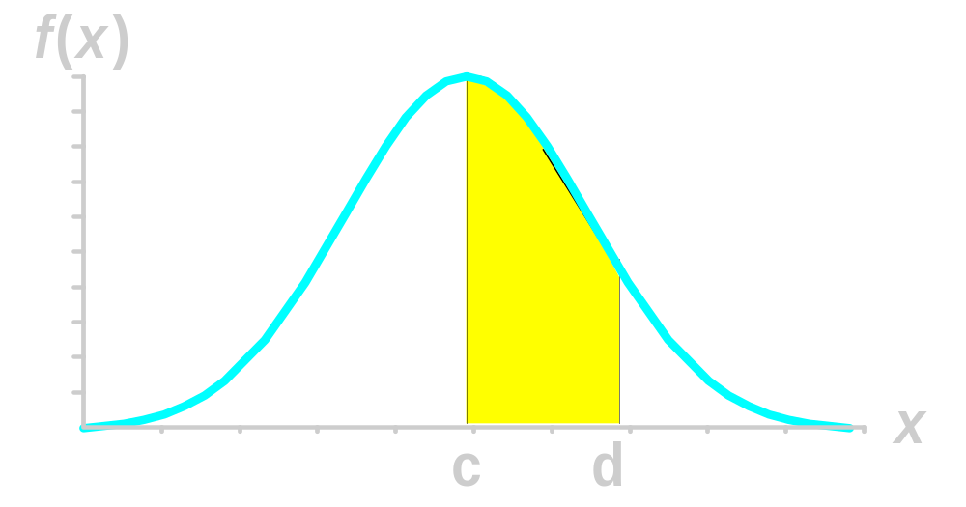
Normal Distribution Probability
Probability is
area under
curve!

Slide 13
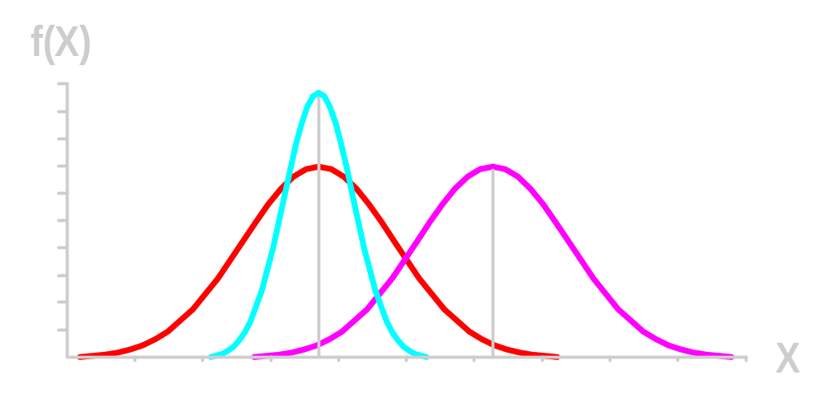
Normal Distribution Probability
Normal distributions differ by mean & standard deviation.

Slide 14
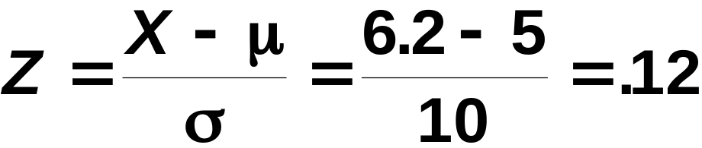
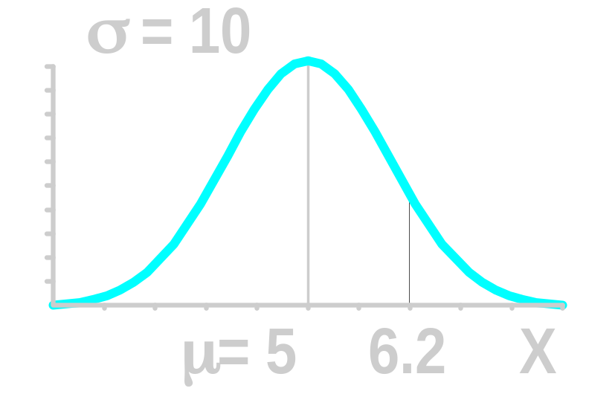
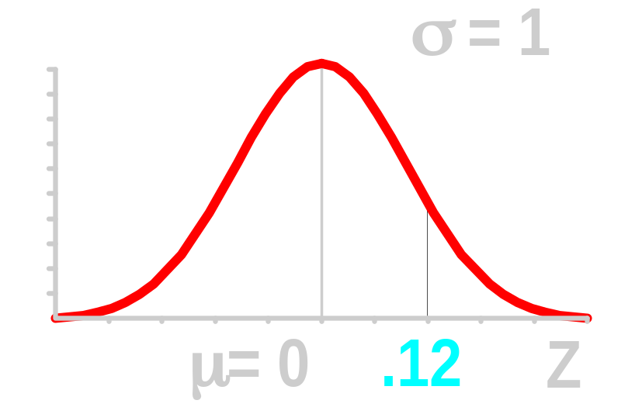
Example: Standardize the Normal Distribution
Normal
Distribution
Standardized Normal Distribution

Slide 15


Normal Probability Tables
The Standardized Normal table in the textbook (Appendix) gives the value of for
.9773
Example:
P(Z < 2.00) = .9773
0
2.00
Z

Slide 16
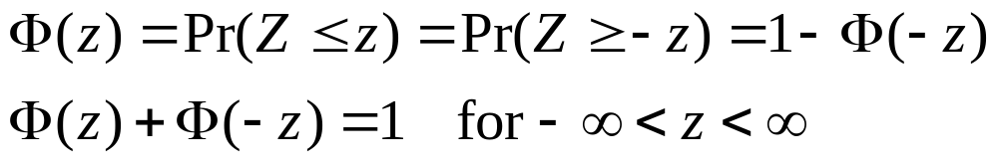

Notice that
So values of can be derived for z<0.
If a random variable X has a normal distribution with mean and variance , then the variable has a standard normal distribution. So probabilities for any normal distribution can be derived.

Slide 17
Normal Distribution Thinking Challenge
You work in Quality Control for GE. Light bulb life has a normal distribution with
μ = 2000 hours & σ = 200 hours. What’s the probability that a bulb will last
A. between 2000 & 2400
hours?
B. less than 1470 hours?

Slide 18
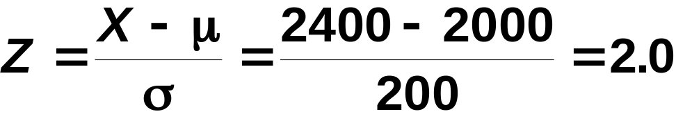
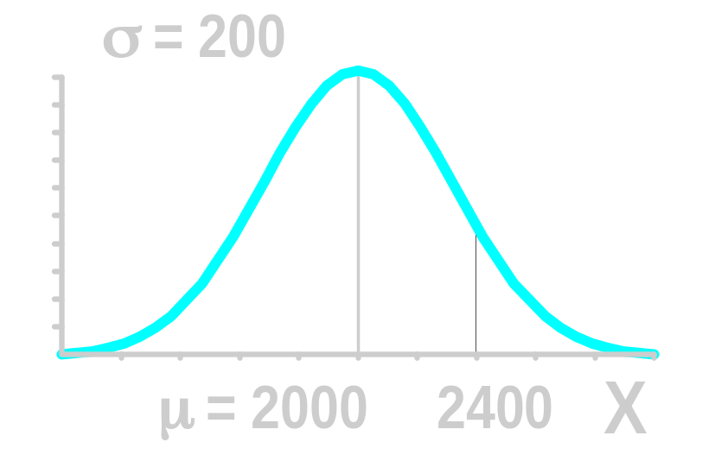
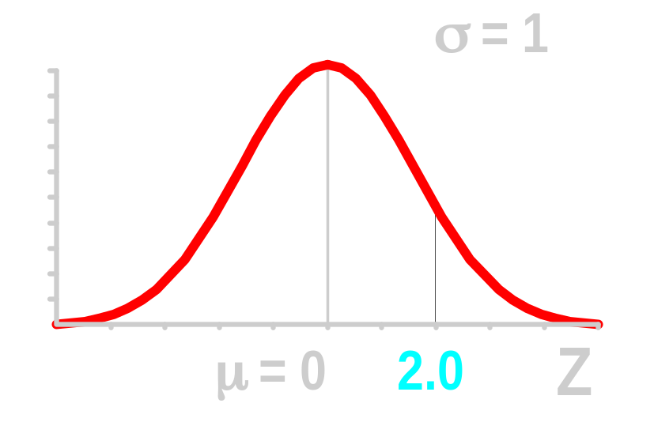
Solution*
P(2000 ≤ X ≤ 2400)
Normal
Distribution
Standardized Normal Distribution
.4773

Slide 19
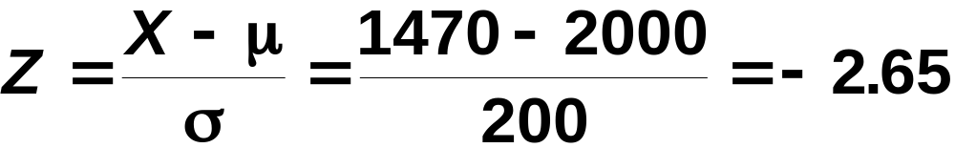
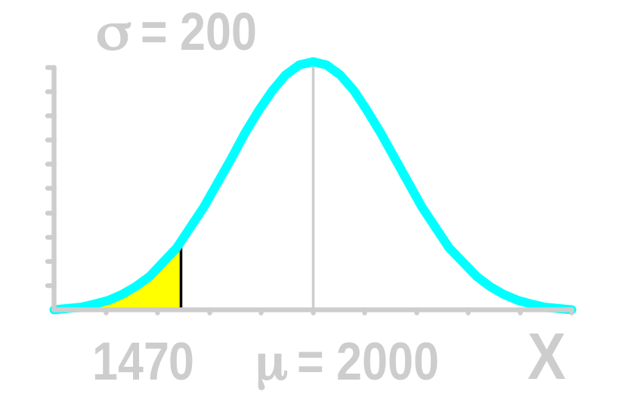
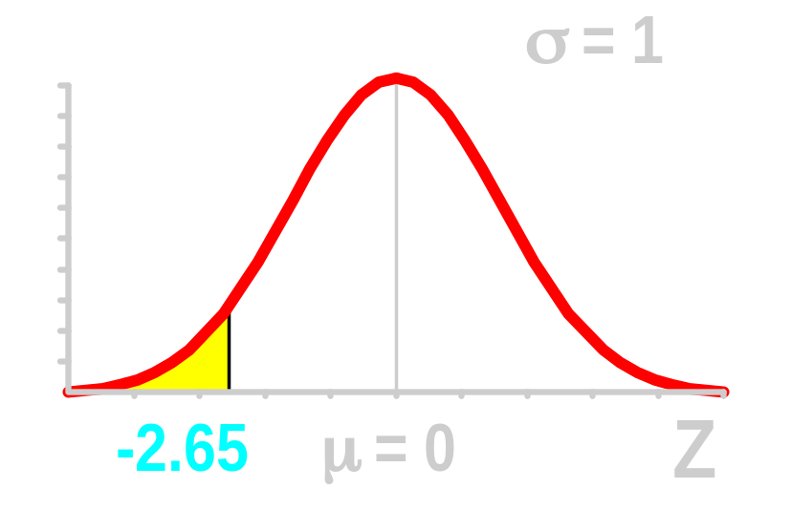
Solution*
P(X ≤ 1470)
Normal
Distribution
Standardized Normal Distribution
.5000
.0040
.4960

Slide 20
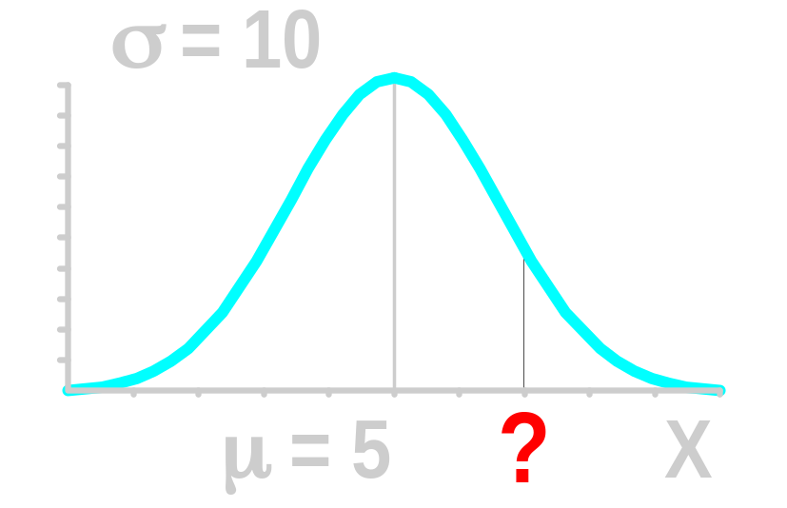
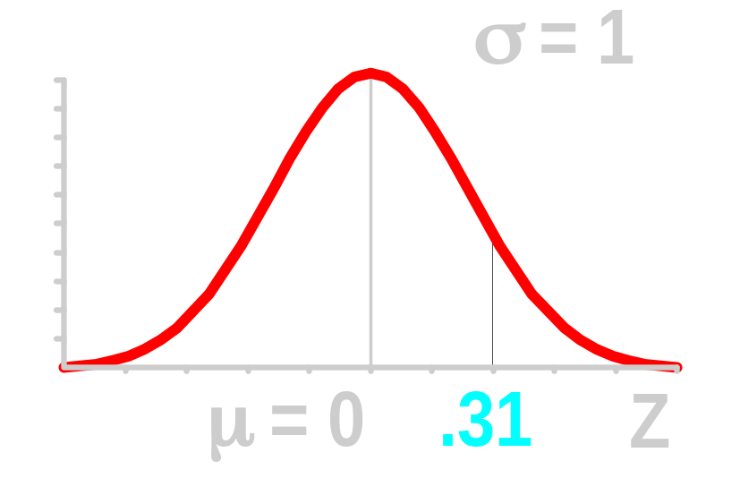
Finding X Values for Known Probabilities
Normal Distribution
Standardized Normal Distribution
.1217
.1217
Shaded areas exaggerated

Slide 21
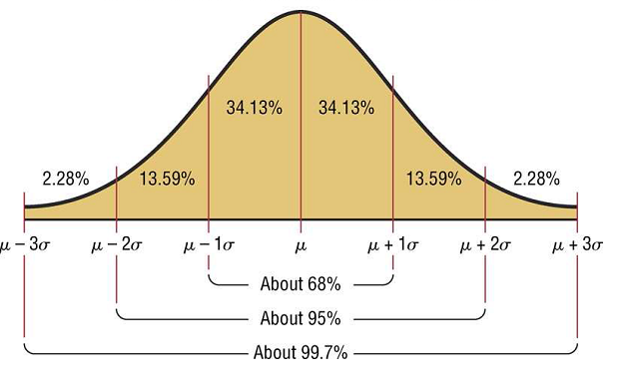
Properties of the Normal Distribution
The area under the part of a normal curve that lies within 1
standard deviation of the mean is approximately 0.68, or 68%;
within 2 standard deviations, about 0.95, or 95%; and within 3
standard deviations, about 0.997, or 99.7%.

Slide 22




Linear Combinations of Normally Distributed Variables
Theorem. If the random variables X1,...,Xk are independent and if Xi has a normal distribution with mean and variance (i=1,...,k), then the sum X1+...+Xk has a normal distribution with mean
and variance .

Slide 23


Corollary 1. If the random variables X1,...,Xk are independent, if Xi has a normal distribution with mean and variance (i=1,...,k), and if a1,...,ak and b are constants for which at least one of the values a1,...,ak is different from 0, then the variable a1X1+...+akXk+b has a normal distribution with mean and variance
.

Slide 24


Corollary 2. Suppose that the random variables X1,...,Xn form a random sample from a normal distribution with and variance , and let denote the sample mean. Then has a normal distribution with mean and variance .

Slide 25
Example 5.6.6
Suppose that the heights, in inches, of the women in a certain population follow a normal distribution with mean 65 and standard deviation 1, and that the heights of the men follow a normal distribution with mean 68 and standard deviation 2. Suppose that one woman is selected at random, and independently, one man is selected at random. What is the probability that the woman will be taller than the man?

Slide 26

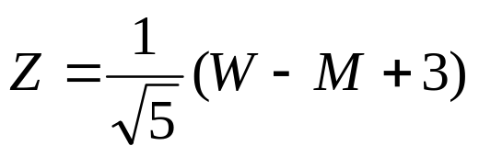
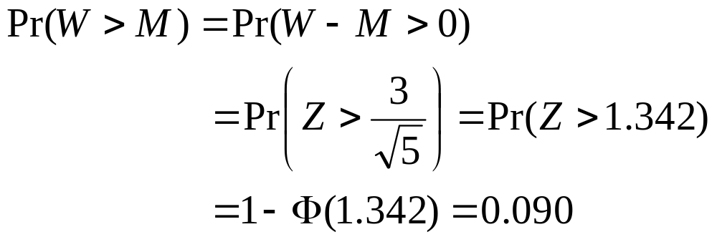
Solution: Let W denote the height of the selected woman, and let M denote the height of the selected man. Then the difference W-M has a normal distribution with mean 65-68=-3 and variance
Let
Then Z has a standard normal distribution. So

Slide 27

Example 5.6.5 Determining a Sample Size
Suppose that a random sample of size n is to be taken from a normal distribution with mean and variance 9. What is the miminum value of n for which

Slide 28
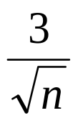
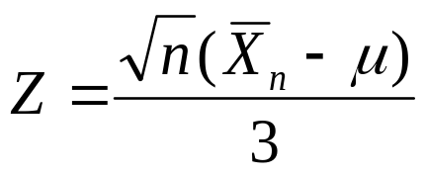
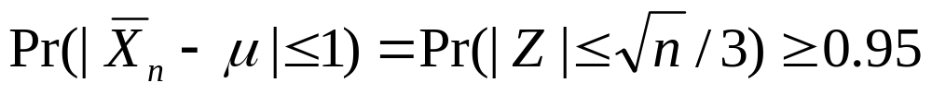

Solution: The sample mean has a normal distribution with mean and standard deviation
Let , then Z has a standard
normal distribution, and
The sample size must be at least 35.

Slide 29

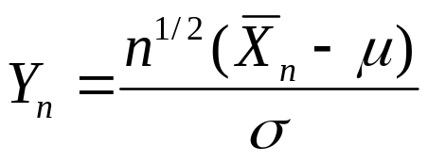
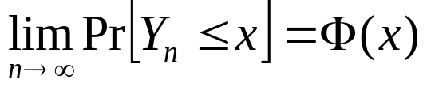
The Central Limit Theorem
The Central Limit Theorem (Lindeberg and Levy) for the Sample Mean.
Theorem 5.7.1. If the random variables X1,...,Xn form a random sample of size n from a given distribution with mean and variance ( ). Let
then for any fixed number x,

Slide 30
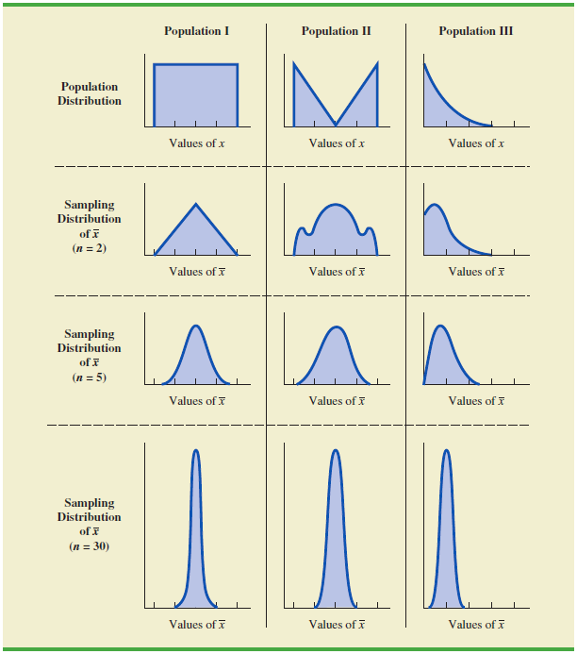

Slide 31

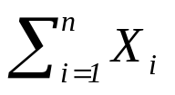


If a large random sample is taken from any distribution with mean and variance ,
regardless of the distributional form,
  The distribution of will be approximately a normal distribution with mean and variance
  The distribution of the sum will be approximately a normal distribution with mean
  and variance .

Slide 32
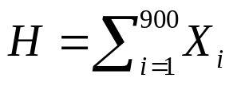

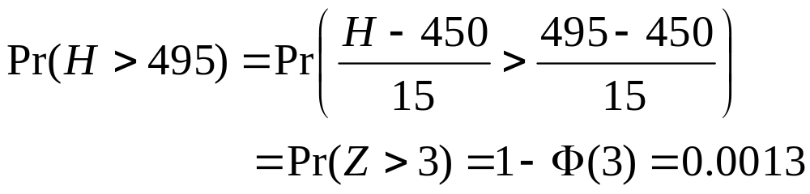
Example: Tossing a Coin
Suppose a fair coin is tossed 900 times. What is the probability of obtaining more than 495 heads?
  For i=1,...,900, let Xi=1 if a head is obtained on the ith toss and let Xi=0 otherwise. Then E(Xi)=1/2 and Var(Xi)=1/4.
  From the central limit theorem, the total number of heads
  will be approximately a normal distribution with mean (900)(1/2)=450, variance (900)(1/4)=225, and standard deviation .
  The variable Z=(H-450)/15 will have approximately a standard normal distribution. Thus,

Slide 33


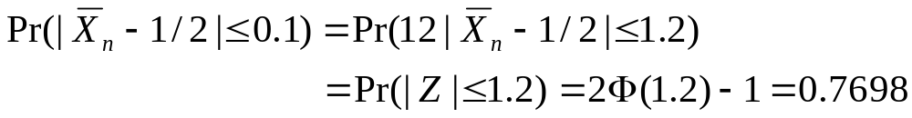
Example: Sampling from a
Uniform Distribution
Suppose that a random sample of size n=12 is taken from the uniform distribution on the interval (0,1). What is the value of ?
  The mean of the uniform distribution on the interval (0,1) is 1/2, and the variance is 1/12.
  From the central limit theorem, the distribution of
  will be approximately a normal distribution with mean 1/2, variance 1/144, and standard deviation 1/12.
  The distribution of will be approximately a standard normal distribution.

Slide 34
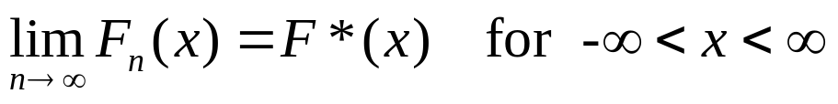
Convergence in Distribution
Let X1,X2,... be a sequence of random variables, and for n=1,2,..., let Fn denote the d.f. for Xn. Let X* denote another random variable with d.f. F*. Assume that F* is a continuous function over the entire real line. Then the sequence X1,X2,... converges in distribution to the random variable X* if

Slide 35
  Sometimes we simply say that Xn converges in distribution to X*, and the distribution of X* is called the asymptotic distribution of Xn.
  In the central limit theorems, the asymptotic distribution of Yn is a standard normal distribution.

